Slide 1
Training Models
Varol Kayhan, PhD

Slide 2
Agenda
Regression recap
Gradient Descent
Stochastic gradient descent
Batch/mini-bath gradient descent
Polynomial regression
Regularization
L1
L2
ElasticNet
Logistic Regression

Slide 3

Recall: Regression
$$y=β_{0}+β_{1}x_{1}+β_{2}x_{2}+β_{3}x_{3}+…+β_{n}x_{n}$$
$β_{0}$ : Intercept
$β_{1}$, …, $β_{n}$ : Beta coefficients
$x_{1}$, … , $x_{n}$ : dimensions, features, variables, predictors

Slide 4

Recall: Regression
$$y=β_{0}+β_{1}x_{1}+β_{2}x_{2}+β_{3}x_{3}+…+β_{n}x_{n}$$
Example:
$Price=100,000−1,000∗Age+10∗SqFt$
Age | SqFt | Price
10 | 2,500 | 110,000
5 | 1700 | 120,000
… | … | …

Slide 5
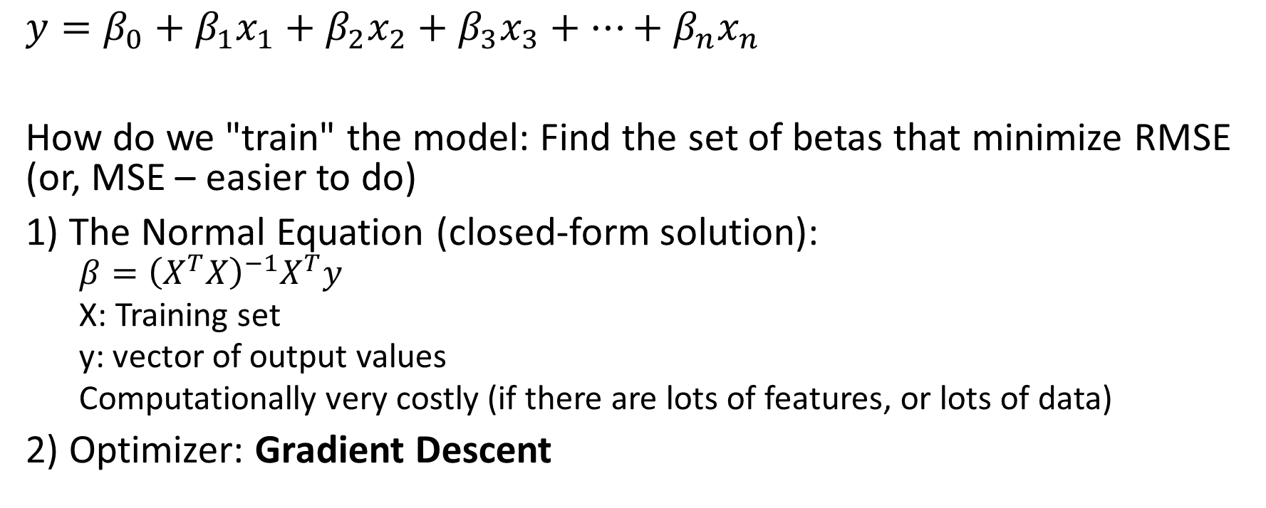
Recall: Regression
$$y=β_{0}+β_{1}x_{1}+β_{2}x_{2}+β_{3}x_{3}+…+β_{n}x_{n}$$
How do we "train" the model: Find the set of betas that minimize RMSE (or, MSE – easier to do)
1) The Normal Equation (closed-form solution):
$${β=\left(X^{T}X\right)}^{−1}X^{T}y$$
X: Training set
y: vector of output values
Computationally very costly (if there are lots of features, or lots of data)
2) Optimizer: Gradient Descent

Slide 6
Gradient Descent
A generic optimization algorithm
Tweak the parameters iteratively to minimize the cost function (SSE, MSE, RMSE, etc.)
What do you mean by "minimize"???
Lost in a mountain
How do you get to the bottom? (i.e., "minimize")
Feel slope below your feet!
Then, go in the direction of steepest (descending) slope

Slide 7
Gradient Descent
Cost
Beta value(s)

Slide 8
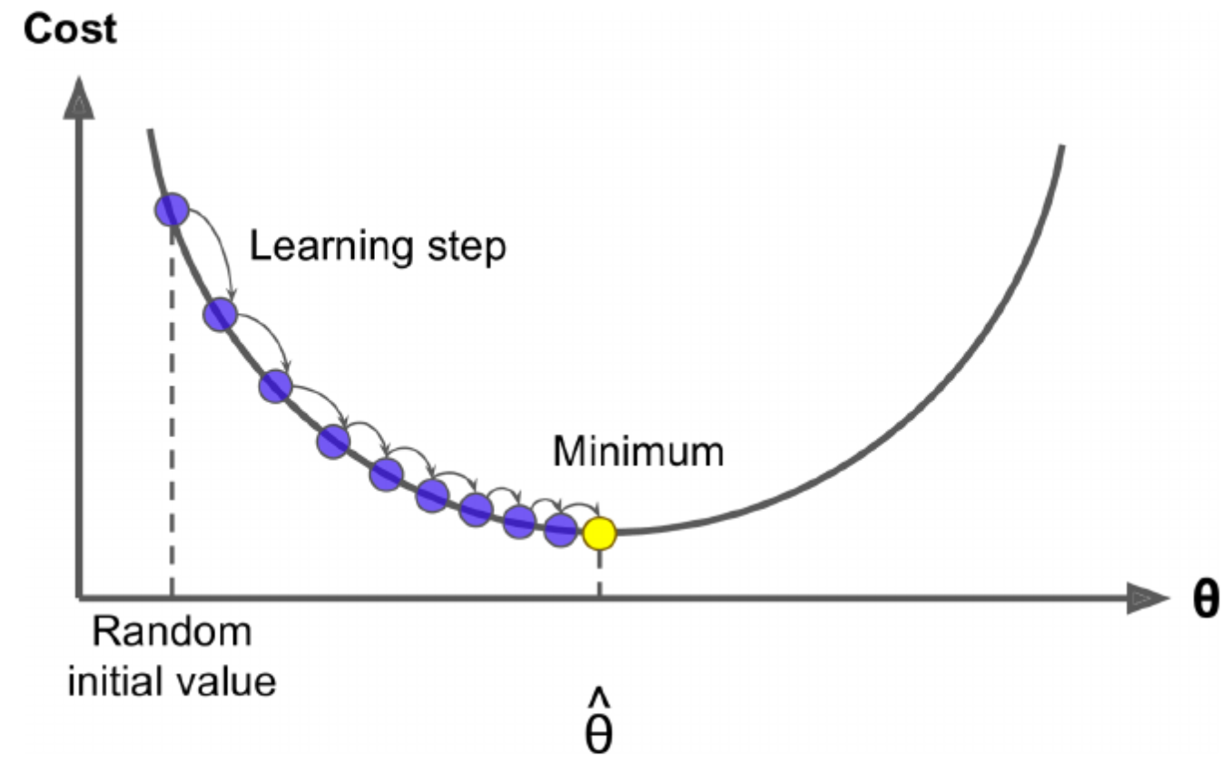
Gradient Descent - Mechanics
Initialize the beta coefficients with random values
Calculate the "gradient" of each beta coefficient
Based on the gradient and "learning rate", change the beta coefficients.
New value = Previous value – learning rate x "gradient value"
If gradient is zero, minimum achieved!

Slide 9
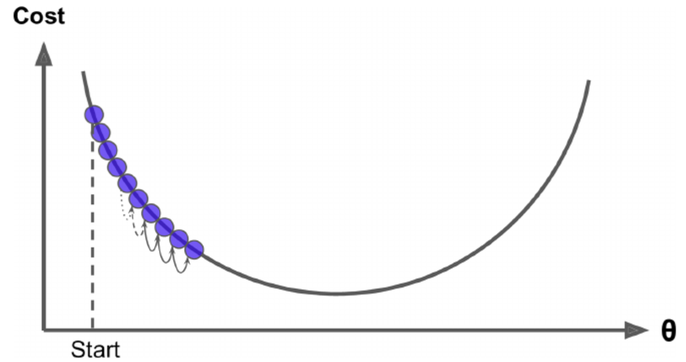
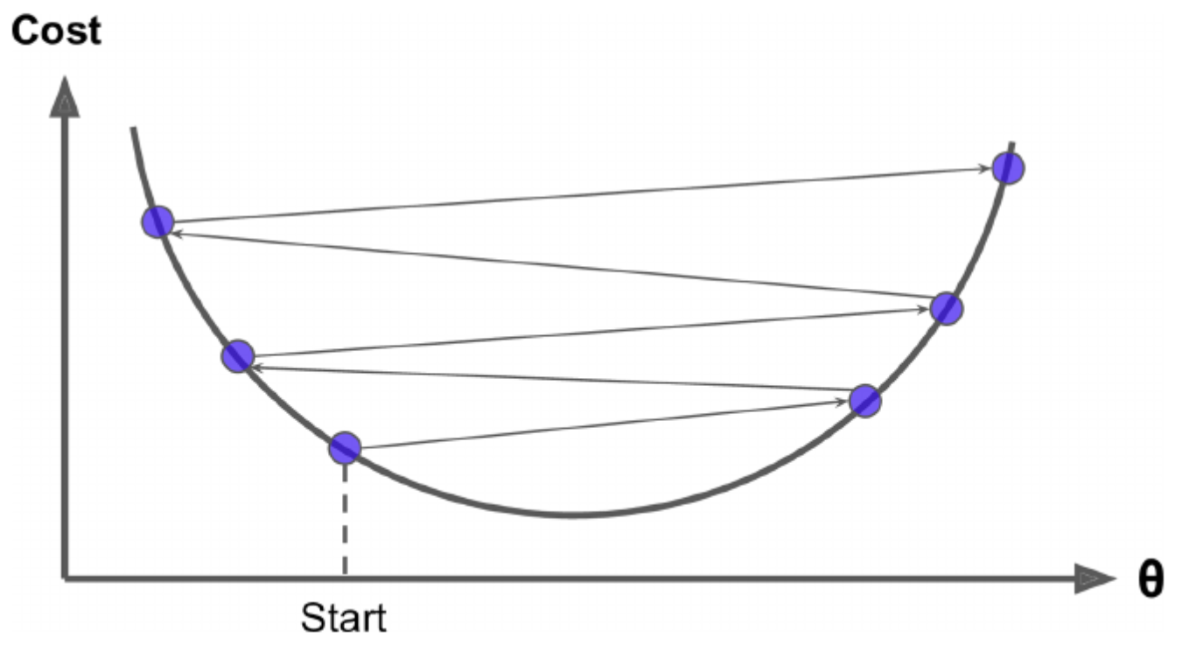
Learning Rate
If too small: too many steps to converge
Might not converge or take too long to converge
It too large: jump around and never reach minimum

Slide 10
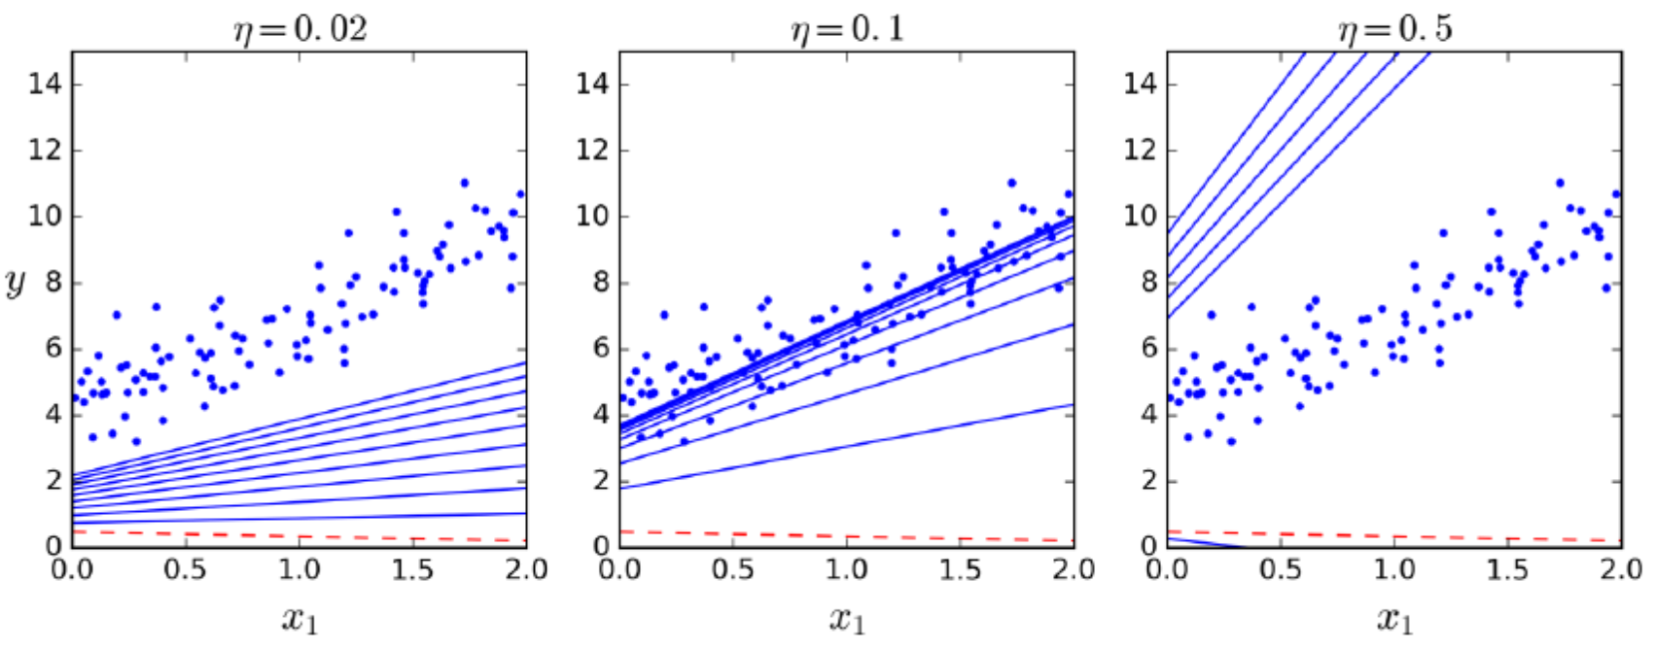
Gradient Descent: Learning Rate
Learning rate too small
Learning rate normal
Learning rate too high

Slide 11
Gradient Descent
Gradient descent example.xlsx

Slide 12
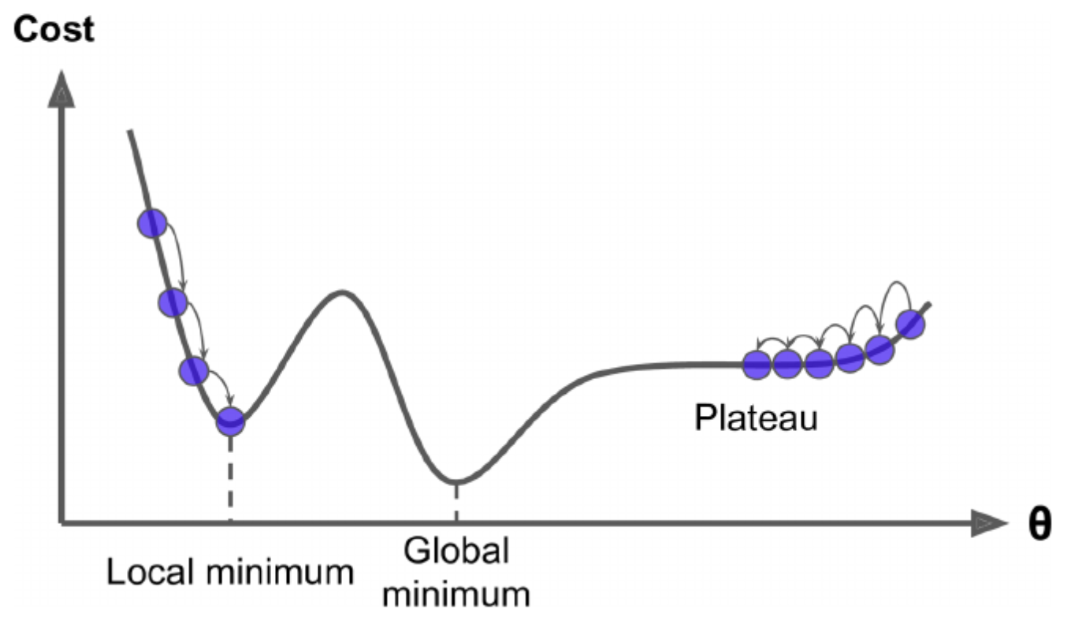
Gradient Descent
Two challenges:
If you are on the left, you will get stuck in the local minimum
If you are on the right, you will get stuck in the plateau

Slide 13
Gradient Descent
MSE is always shaped like a bowl
Only one global minimum
No local minimum
MSE is a continuous function (the slope doesn't change abruptly)
So: it is guaranteed to approach to global minimum
However, always standardize your numerical variables
Non-standardized variables change the shape of bowl, you might end up with “plateaus”

Slide 14
Batch Gradient Descent
Uses the “entire” training set to calculate MSE at every step
Calculate MSE
If the gradient vector points “uphill” go in the opposite direction allowed by the “learning rate”
Repeat
Can be very slow if you have a large set

Slide 15
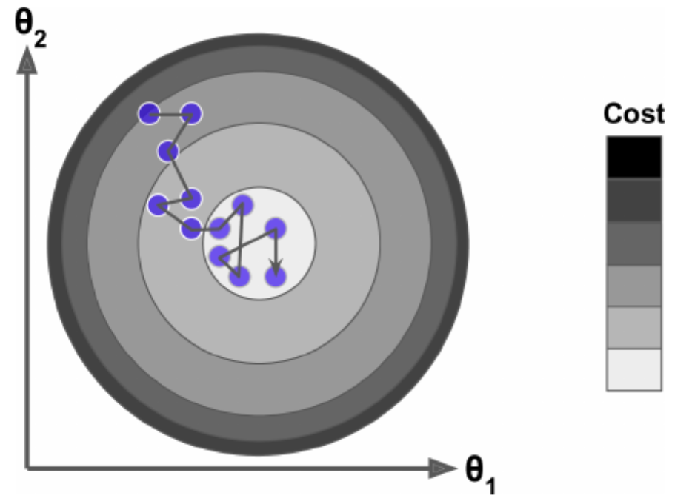
Stochastic Gradient Descent
Stochastic = random
Pick a random instance at every step
Calculate the gradients for that instance only
(Gradient decreases on average)
Much faster than batch gradient
Problem: jumps around (even at global min)
It is instance specific
The final parameter estimates are not optimal

Slide 16
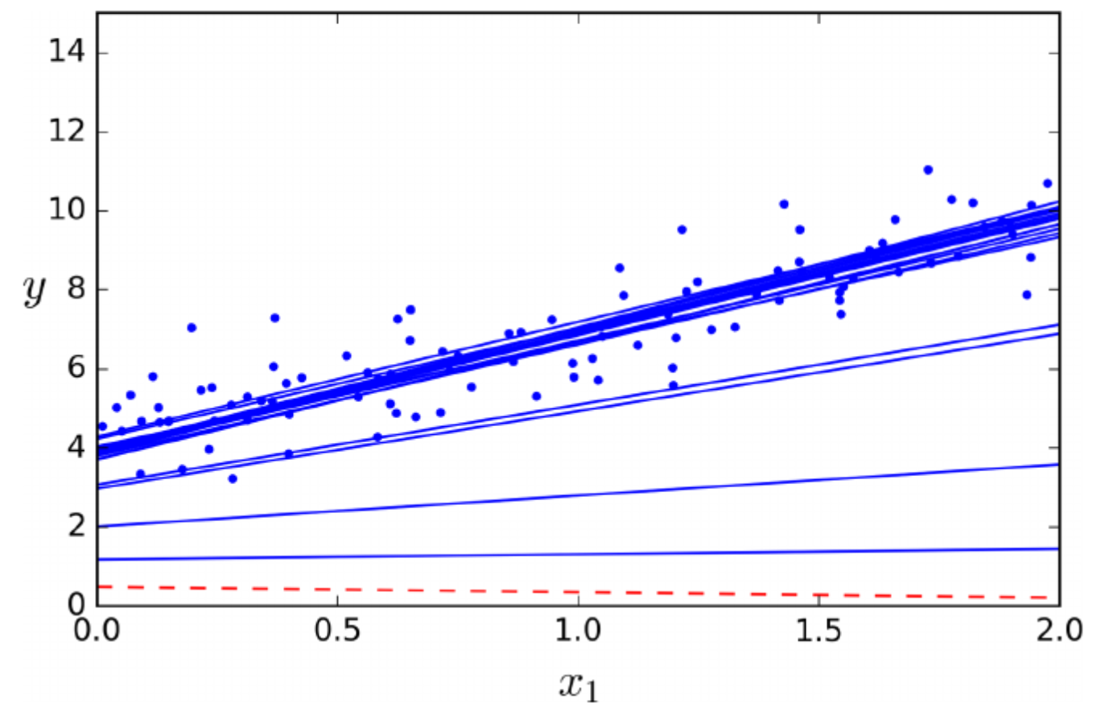
Stochastic Gradient Descent
Better if the cost function is not like a “bowl”
It can get out of local minima
But it can never converge on the minimum
Solution: gradually decrease the learning rate
i.e., “learning schedule”

Slide 17
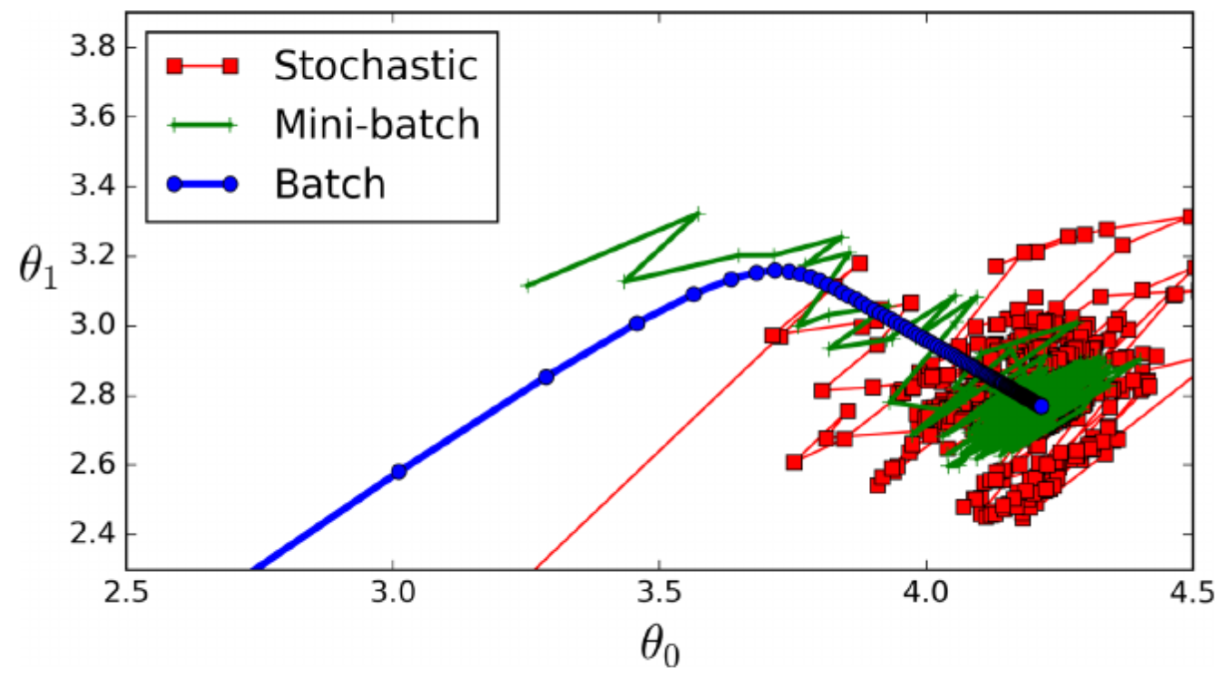
Mini-Batch Gradient Descent
Calculates the gradient on a small subsample (i.e., mini-batch)
Batch uses the entire data set
Stochastic uses one instance at a time
Mini-batch uses a subsample at a time
Less erratic than stochastic gradient

Slide 18
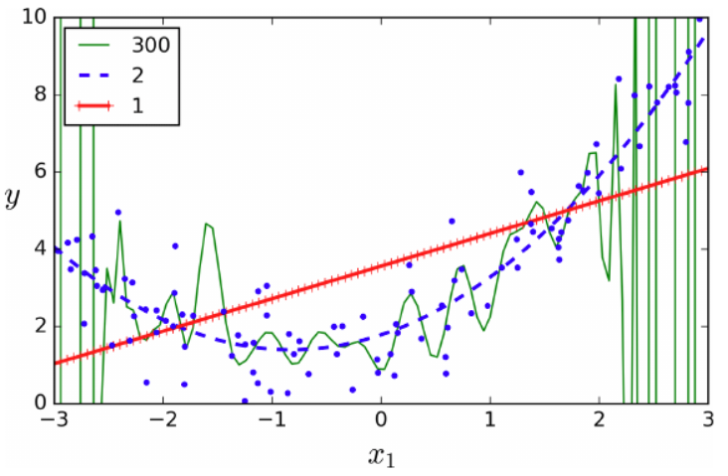

Polynomial Regression
Regression with polynomial terms: $y=β_{0}+β_{1}x_{1}+β_{2}x_{1}^{2}+…$
Used when you think regression line is "curved"
The higher the degree, the more likely to overfit!

Slide 19
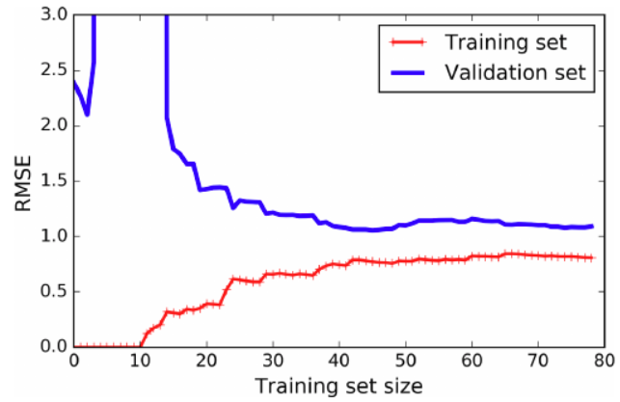
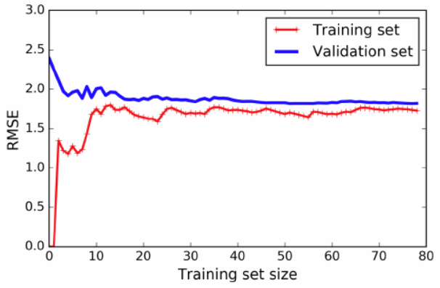
Learning Curves
Overfitting:
Models performs well on training, but not on validation
Underfitting:
Model performs worse on both

Slide 20
Regularization:
A technique to reduce overfitting
A technique to "penalize the model complexity" (so you don't learn too much)
"Constrains" the weights (i.e., betas) of the model
Two types:
L2 Regularization (i.e., Ridge Regression)
L1 Regularization (i.e., Lasso Regression)

Slide 21
L2 Regularization (Ridge Regression)
Goal: model simplicity
A regularization term is added to the cost function
Forces the algorithm to keep the beta coefficients as small as possible
Used only in training
Validation is performed on unregularized model

Slide 22
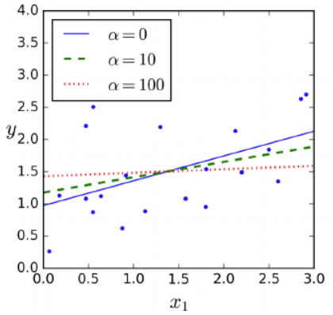
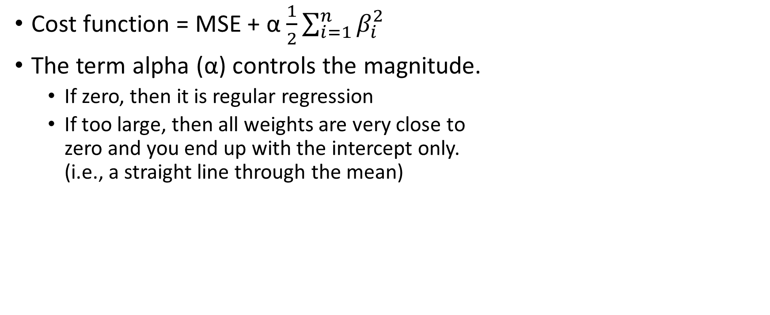
L2 Regularization (Ridge Regression)
Cost function = MSE + α $\frac{1}{2}\sum_{i=1}^{n}{β_{i}^{2}}$
The term alpha (α) controls the magnitude.
If zero, then it is regular regression
If too large, then all weights are very close to zero and you end up with the intercept only. (i.e., a straight line through the mean)
alpha value
Complex model (overfitting)
Very simple model (underfitting)
Very low
Very high

Slide 23
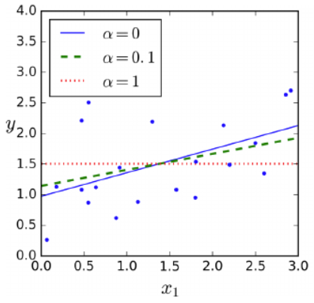
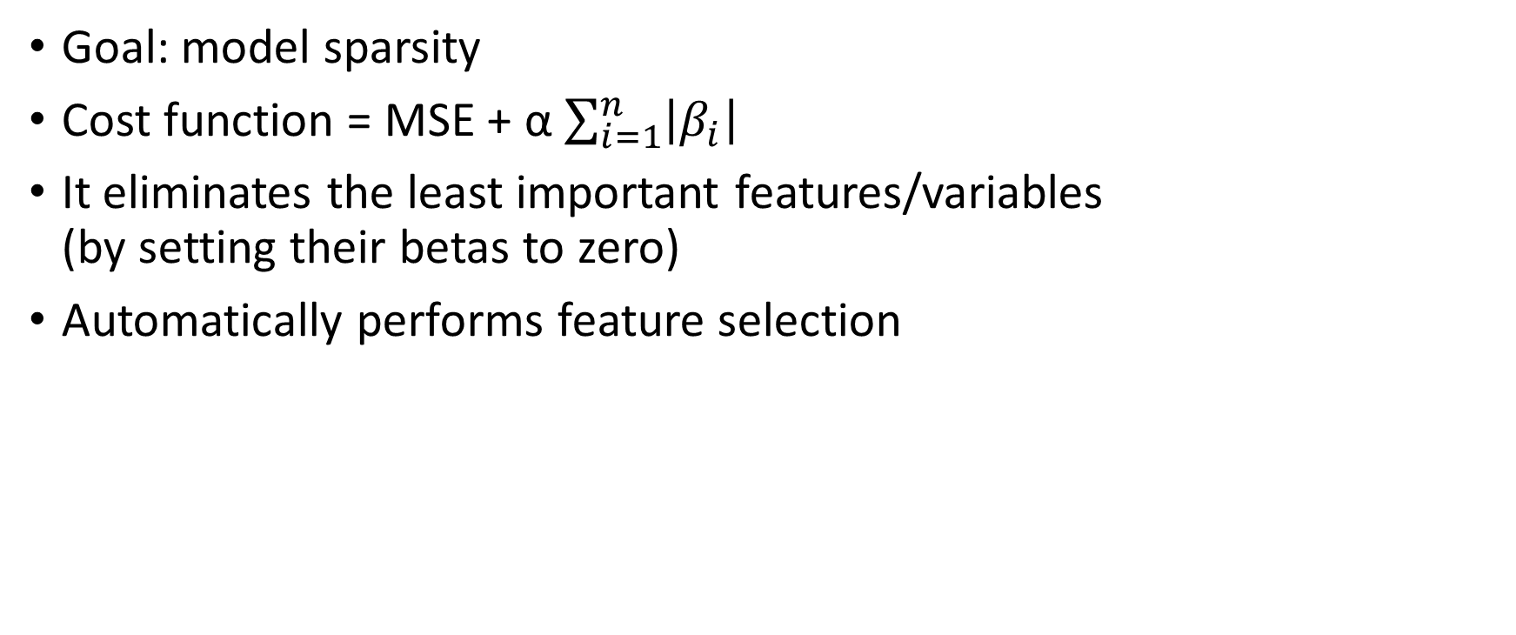
L1 Regularization (Lasso Regression)
Goal: model sparsity
Cost function = MSE + α $\sum_{i=1}^{n}{\left|β_{i}\right|}$
It eliminates the least important features/variables (by setting their betas to zero)
Automatically performs feature selection

Slide 24
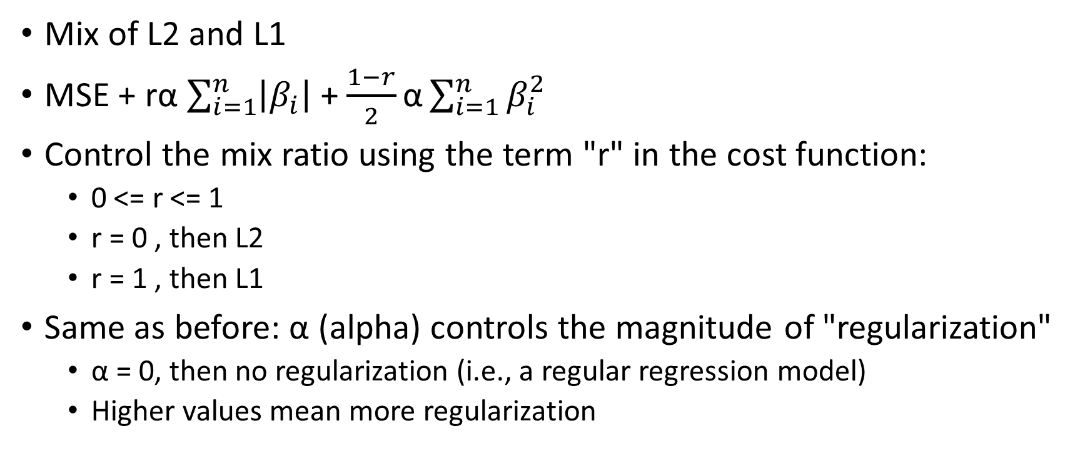
Elastic Net
Mix of L2 and L1
MSE + rα $\sum_{i=1}^{n}{\left|β_{i}\right|}$ + $\frac{1−r}{2}\text{α}\sum_{i=1}^{n}{β_{i}^{2}}$
Control the mix ratio using the term "r" in the cost function:
0 <= r <= 1
r = 0 , then L2
r = 1 , then L1
Same as before: α (alpha) controls the magnitude of "regularization"
α = 0, then no regularization (i.e., a regular regression model)
Higher values mean more regularization

Slide 25
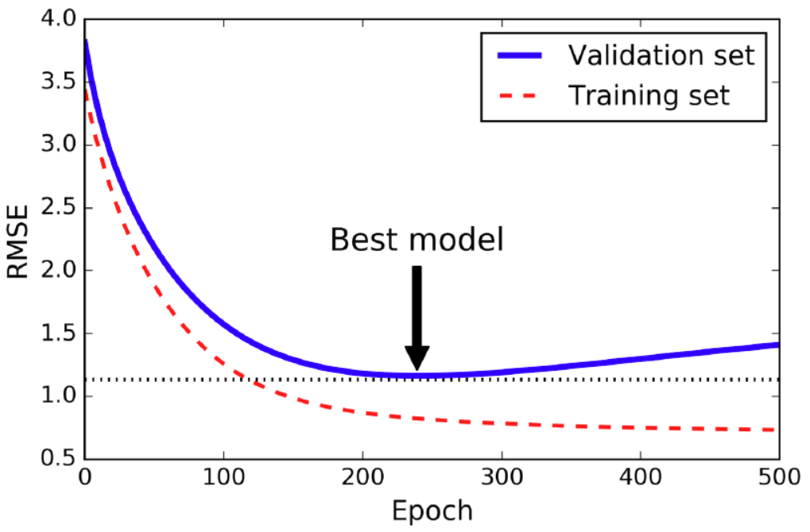
Early Stopping
Another regularization technique: stop when validation error is minimum
Is it baked into the algorithms?
Yes&No
(Sometimes, you have to write your own)

Slide 26
Logistic Regression
Regression for binary outcomes
Works just like regular regression
Output is probability of belonging to class 1 (vs. 0)
No known closed-form to find the beta coefficients
Uses gradient descent
Cost function is like a bowl, so guaranteed global minimum
Can be regularized using both L1 and L2

Slide 27
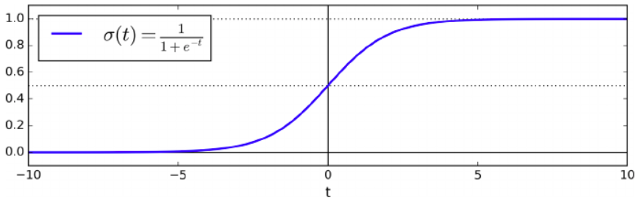

Logistic Regression
The output value is constrained between 0 and 1
Logistic function = $\frac{1}{1+e^{−t}}$

Slide 28
Softmax Regression
Also know as, "Multinomial Logistic Regression"
Used for multi-class classification
Finds probabilities of each class using the softmax function
Class is assigned using the highest estimated probability
Uses the cross-entropy cost function
If classes = 2, reverts back to logistic regression
Uses gradient descent for optimization

Slide 29
Python Cheatsheet
eta0: learning rate in gradient descent algorithms
alpha (α): regularization hyperparameter (for both L2 and L1)
l1_ratio: the mix ratio of r in Elastic Net
C: regularization hyperparameter for softmax regression

Slide 30
Conclusion
Regression recap
Gradient Descent
Stochastic gradient descent
Batch/mini-bath gradient descent
Polynomial regression
Regularization
L1
L2
ElasticNet
Logistic Regression

